Slide 1


Developing a Methodology for Detecting Bit Error Frames in CAN Networks(Vector CANoe)
Term Project
By:
SANGANA SAI VENKATA SURYA TEJA(EE23MTECH11032)

Slide 2
Contents:
Abstract (Motivation/Relevance of the project)
Specific objectives/goals of the project
Introduction To Controller Area Network(CAN)
Error Handling in CAN
Bit Error Frames
Detecting Bit Error Frames
Conclusion

Slide 3
Abstract (Motivation/Relevance of the project)
The Controller Area Network (CAN) protocol is a widely utilized communication standard in automotive and industrial applications due to its robustness, reliability, and cost-effectiveness. CANoe, developed by Vector Informatik, is a comprehensive software tool that offers capabilities for developing, testing, analyzing, and maintaining CAN systems. Bit errors, though rare, can have significant consequences on system reliability and safety. Therefore, the ability to detect and analyze bit error frames is crucial for maintaining the integrity of CAN-based systems.
This project aims to design simple CAN network and develop a methodology for detecting bit error frames in CAN networks using simulation in CANoe. The motivation behind this project lies in the necessity to enhance the fault-tolerance capabilities of CAN networks by accurately identifying and analyzing bit error frames. By simulating various error scenarios in CANoe, this project seeks to provide insights into the behavior of CAN networks under different conditions and facilitate the development of robust error-handling mechanisms.

Slide 4
Abstract (Motivation/Relevance of the project)
In conclusion, this project endeavors to contribute to the advancement of CAN network reliability by providing a systematic approach to detecting bit error frames through simulation in CANoe. By addressing this aspect of CAN communication, the project aims to foster innovation and enhance the performance of CAN-based systems across various industries, ultimately leading to safer and more dependable technological solutions.

Slide 5
Specific objectives/goals of the project
This project focuses on developing a methodology for detecting bit error frames within Controller Area Network (CAN) networks using simulation in CANoe.
Importance: Accurately identifying and analyzing bit error frames is crucial for enhancing fault-tolerance capabilities in CAN networks. Bit errors, though infrequent, can have significant ramifications on system reliability and safety. Hence, the project underscores the importance of robust error detection mechanisms.
Significance of Simulation: Simulating various error scenarios in CANoe offers a unique opportunity to gain insights into CAN network behavior. By replicating real-world conditions, we can observe how different factors impact error occurrence and propagation. This facilitates the development of robust error-handling mechanisms tailored to specific network conditions.

Slide 6
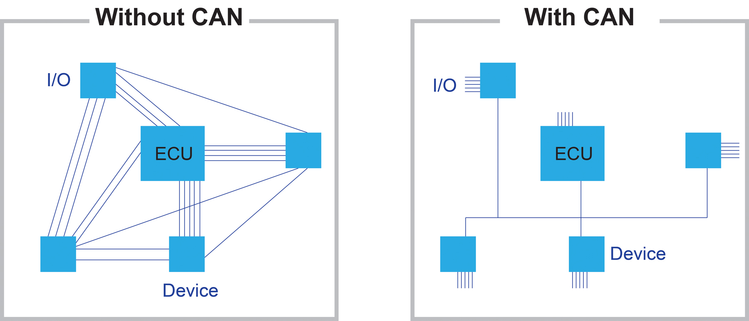

Slide 7
Introduction To Controller Area Network(CAN):
The Controller Area Network (CAN) is a robust and widely used communication protocol in automotive and industrial applications.
Developed by Bosch in the 1980s, CAN has since become a standard for reliable and efficient communication between electronic control units (ECUs) within vehicles and industrial systems.
Importance in Automotive and Industrial Applications:
In automotive applications, CAN facilitates communication between various ECUs responsible for functions such as engine management, transmission control, braking systems, and more.
In industrial settings, CAN enables seamless communication between controllers, sensors, actuators, and other devices, enhancing automation and control processes.
Error Handling Mechanisms in CAN:
CAN incorporates sophisticated error handling mechanisms to ensure reliable data transmission in noisy and challenging environments.
Key error handling features include cyclic redundancy check (CRC), bit stuffing, acknowledgment mechanisms, and error frames, which collectively contribute to the protocol's robustness and fault tolerance.

Slide 8
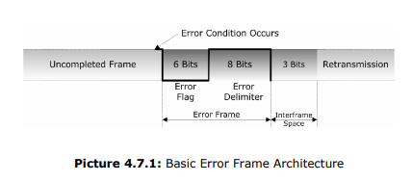
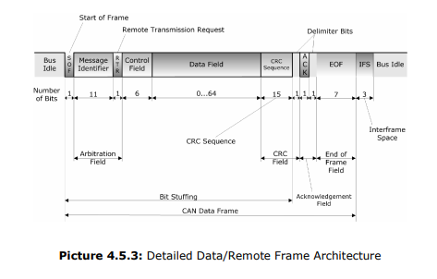
CAN DATA AND ERROR FRAME

Slide 9
Error Handling in CAN:
The Controller Area Network (CAN) protocol employs sophisticated error handling mechanisms to ensure reliable data transmission.
These mechanisms include cyclic redundancy check (CRC), bit stuffing, acknowledgment mechanisms, and error frames, collectively enhancing the protocol's robustness in challenging environments.

Slide 10
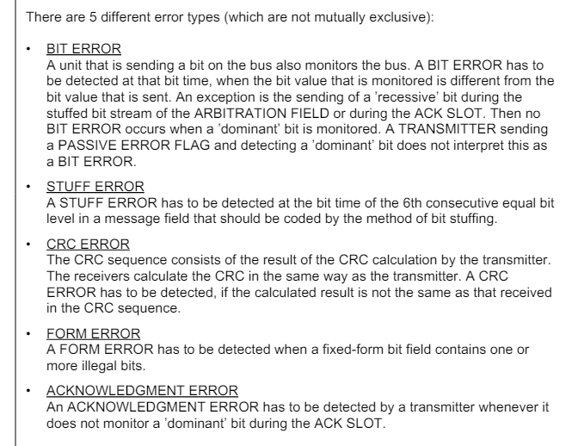
Introduction to Different Types of Errors:

Slide 11
Bit Error Frames:
Bit error frames in the Controller Area Network (CAN) protocol signify errors occurring at the bit level within data frames during transmission.
These errors indicate discrepancies between the transmitted and received bits, compromising the integrity of the data being communicated.
Causes of Bit Errors:
Bit errors can arise due to various factors, including electrical noise, signal reflections, electromagnetic interference (EMI), voltage transients, and hardware malfunctions.
High-speed communication, long cable lengths, and improper termination can exacerbate the occurrence of bit errors in CAN networks.
Impact on CAN Communication:
Bit errors can have significant repercussions on the reliability and performance of CAN communication.
They can lead to corrupted data, communication disruptions, and potential malfunctions in CAN-based systems, particularly in safety-critical applications.
Detecting and mitigating bit error frames is crucial for maintaining the robustness and fault tolerance of CAN networks, ensuring the integrity of data transmission.

Slide 12
Detecting Bit Error Frames:
Utilizing Simulation: The methodology employs simulation in CANoe to accurately replicate the behavior of CAN networks. This allows us to create controlled environments for experimentation and analysis, providing insights into how bit error frames manifest under different conditions.
Designing Error Scenarios: Various error scenarios are designed within CANoe to simulate different conditions encountered in real-world CAN networks. By introducing controlled errors, we can observe the behavior of the network and assess the effectiveness of detection methods.
Developing Detection Algorithms: Advanced algorithms are developed to detect and analyze bit error frames within the simulated CAN network. These algorithms leverage the data collected during simulation to accurately identify instances of bit errors and distinguish them from legitimate data packets.
Validating Effectiveness: The developed detection methods are rigorously validated through testing and analysis. By subjecting the simulated CAN network to a range of scenarios and error conditions, we can assess the accuracy and efficiency of the detection algorithms, ensuring they meet the required performance criteria.

Slide 13
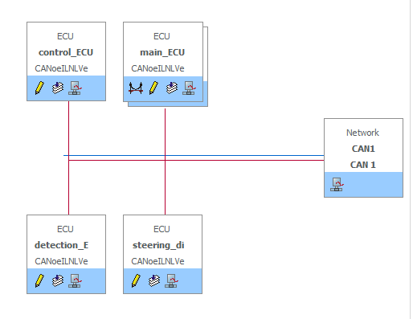
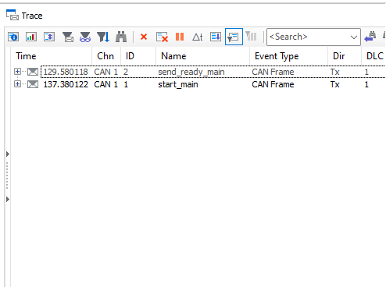
Results: CAN NETWORK
CAN Frames

Slide 14
Conclusion
Throughout this project, we have aimed to develop a robust methodology for detecting bit error frames in Controller Area Network (CAN) networks using simulation in CANoe. By focusing on accurately identifying and analyzing bit error frames, we have underscored the importance of enhancing fault-tolerance capabilities in CAN networks.
Importance of Fault-Tolerance: Enhancing fault-tolerance capabilities is imperative for ensuring the reliability and safety of CAN-based systems, particularly in industries such as automotive, aerospace, and industrial automation. Bit errors, though infrequent, can have significant repercussions, making robust error detection mechanisms indispensable.
Potential Impact: The successful implementation of our methodology has the potential to significantly improve the reliability and performance of CAN-based systems. By effectively detecting and mitigating bit error frames, we can minimize system malfunctions, enhance safety, and reduce downtime, thereby increasing operational efficiency.
Contribution to Innovation: This project contributes to fostering innovation and advancing technology in various industries reliant on CAN networks. By providing a systematic approach to detecting bit error frames, we empower organizations to develop more resilient and dependable CAN-based solutions, driving progress and innovation in the field.
In conclusion, our efforts in developing a methodology for detecting bit error frames in CAN networks not only enhance fault-tolerance capabilities but also pave the way for safer, more reliable, and innovative technological solutions across industries

Slide 15
Reference for how to introduce disturbances in CAN networks using Vector interface:
Webinar: https://vector-group.webex.com/vector-group-eng/lsr.php?RCID=b8fab3ca00f23b55dce33fbd2b88aa9b
>>FAQ - CAN Disturbance Interface VH6501
>>VH6501 Basic Configuration
>>Disturbing the CAN Communication at the ACK Slot With the VH6501
>>https://support.vector.com/kb?id=kb_article_view&sysparm_article=KB0014312

